Slide 1

Reconstructing the 3D wind with a Physics-Constrained Fourier Neural Operator
First progress review
End-of-studies project 2026
From ANEO surface sensors at ≈ 25 m to a mass-conserving wind field up to 1000 m
Presented by
Supervisor
Host
Ines Rouatbi
Rayen Ben Amor
Tukhnanutha · ISI / ESPRIT
Notes:
First progress review: where the project stands, what is built, the first results and what comes next.

Slide 2
Eight stops, following CRISP-DM
ROADMAP OF THIS REVIEW
01
02
03
04
05
06
07
08
Context
Business understanding
Data understanding
Preparation & features
Modeling
First results
Deployment plan
Next steps
PC-FNO3D · First progress review · ANEO
2

Slide 3
Measuring the ground, guessing the sky
01
CONTEXT
ANEO sensors give a dense picture at 25 m. Everything above them is unknown.
3

Slide 4
Dense at the surface, blind above
THE ANEO NETWORK · TUKHNANUTHA
500 000
surface points
1000 × 500 grid, 50 m apart
50 × 25 km
study domain
terrain from 5 to 526 m
7
variables per sensor
T, ρ, RH, p and wind u, v, w
PC-FNO3D · First progress review · ANEO
4
Notes:
Each orange dot is a sensor. The blue rings are what we want: the wind at 250, 500 and 1000 m, where nothing is measured.

Slide 5


Two questions drive the project
PROBLEM STATEMENT
“Imagine you need the wind speed at 500 m… and no sensor exists at that height.”
Q1 · Reconstruction
Q2 · Physical consistency
How can we rebuild a continuous 3D wind field (u, v, w) from 25 to 1000 m using only measurements taken near the ground?
How can we make sure the field obeys physics: mass conservation ∇·(ρv) = 0 and air following the terrain?
PC-FNO3D · First progress review · ANEO
5

Slide 6






Every family misses at least one requirement
EXISTING APPROACHES
Kriging / RBF
CFD Navier–Stokes
CNN / U-Net
＋ Simple and fast
＋ Exact physics
＋ Fast to train and run
− No physics at all
− Hours per run, needs initial conditions
− Local view, no physics
PINNs
Neural operators
PC-FNO3D · ours
＋ Physics in the loss
＋ Global and fast (FFT)
＋ Global, fast, physics-constrained
− Slow and hard to scale in 3D
− Physics absent by default
− Learned from a synthetic truth
PC-FNO3D · First progress review · ANEO
6

Slide 7
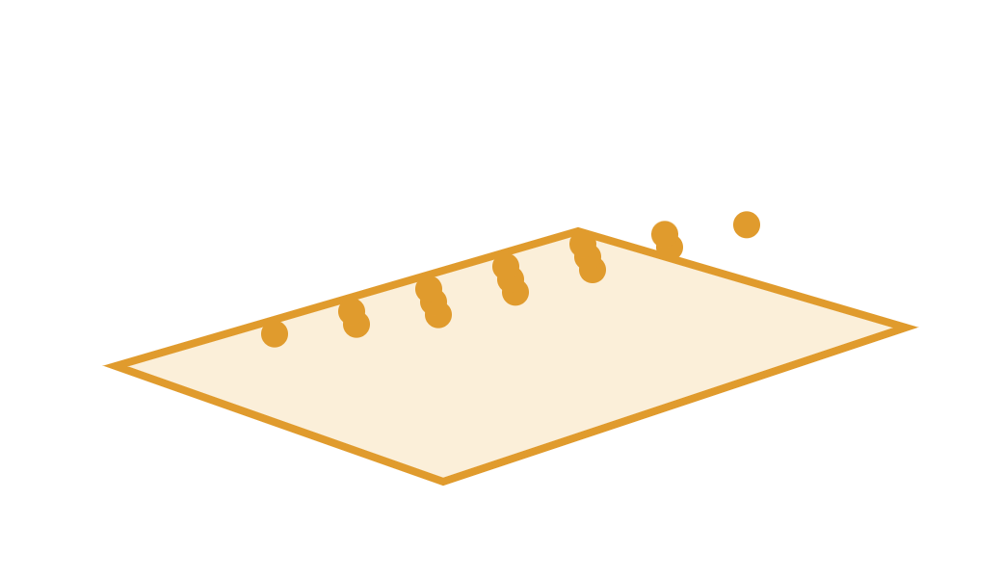


Why the final model is PC-FNO3D
FROM 2D TO 3D
PC-FNO2D · first step
PC-FNO3D · final model
One surface plane, 18 channels. Test R² u 0.988 at 25 m, but no truth aloft to check the altitude profile, and only the 2D divergence in the loss.
A Fourier transform over (z, y, x): 12 levels up to 1 km, scored against an independent 3D truth, with full 3D continuity in the loss.
PC-FNO3D · First progress review · ANEO
7

Slide 8
Business understanding
02
CRISP-DM · PHASE 1
What the project must deliver (business objectives) and how each goal is measured (data-science objectives).
8

Slide 9





Four business objectives
BUSINESS UNDERSTANDING · BOS
BO1
3D wind up to 1000 m
BO2
Physically realistic
Reconstruct the wind field from the ground to 1 km using only ANEO surface data.
Predictions respect mass conservation and the terrain boundary condition.
Business objectives
BO3
Continuous, no artefacts
BO4
Near real time
A smooth, usable field for the virtual nodes, without spurious noise.
Each measurement instant is reconstructed fast enough for operations.
PC-FNO3D · First progress review · ANEO
9
Notes:
Each BO comes from the problem statement: reliable, physically coherent, continuous and near real time.

Slide 10




Each business objective gets a measurable target
BUSINESS UNDERSTANDING · DSOS
DSO1
DSO2
DSO3
DSO4
DSO5
Accuracy
Mass conservation
Continuity
Speed
Robustness
≤ 0.5 m/s
≤ 1.1
< 1 s
≤ 0.7 m/s
≤ 1e-4
RMSE of u, v on the 3D nodes · R² ≥ 0.95 at every level for u, v and w
Roughness of prediction / truth: no spurious noise
Inference time per instant on one GPU
RMSE of u, v with only 25 % of sensors
Mean RMS of ∇·(ρv) in kg·m⁻³·s⁻¹
serves BO1
serves BO2
serves BO3
serves BO4
serves BO1 · BO4
Protocol: 15 unseen test days · 120 synoptic instants · 50 % of sensors visible. w (a few cm/s) is held to the R² target only: a 0.5 m/s RMSE would be meaningless for it.
PC-FNO3D · First progress review · ANEO
10

Slide 11

Where the project stands today
METHODOLOGY · CRISP-DM
1
Business understanding
Done
BOs and DSOs defined
6
1
2
Data understanding
Done
3D dataset v2 analysed
3
Data preparation
Done
5
CRISP-DM
2
Cache, pooling, feature engineering
4
Modeling
Done
PC-FNO3D trained (140 epochs)
4
3
5
Evaluation
In progress
Test results, DSO status
6
Deployment
In progress
Engine + 3D app built, hosting next
PC-FNO3D · First progress review · ANEO
11

Slide 12
Data understanding
03
CRISP-DM · PHASE 2
A full year of the atmosphere: noisy sensors at the surface, a noise-free truth on 12 levels aloft.
12

Slide 13
One year of 3D atmosphere in numbers
DATASET V2 · 1 JAN – 28 DEC 2025
100
1 000
12
days
instants
altitude levels
≈ 8 per month, every season
synoptic, minute and 10-second
from 25 m to 1000 m above sea level
1.35 M
1.35 B
≈ 40 GB
points per instant
rows in total
compressed
500 000 surface + 849 184 virtual nodes
one row per point and instant
100 daily csv.gz files
PC-FNO3D · First progress review · ANEO
13

Slide 14

Three kinds of instants
DATA UNDERSTANDING
800 · synoptic
8 per day at 00, 03, 06 … 21 UTC
1 000
180 · minute episodes
instants
10 episodes of 18 minutes: sunrise, breeze, front, gusts
20 · 10-second episodes
2 episodes of 10 instants
Episodes share the same hour, so each instant is identified by timestamp_utc (minutes and seconds included).
PC-FNO3D · First progress review · ANEO
14

Slide 15


How much of the domain each level covers
DATA UNDERSTANDING · VERTICAL LEVELS
1000 m
100 %
800 m
100 %
650 m
100 %
500 m
99.3 %
Levels under the relief
400 m
96.7 %
Nodes below the terrain, or less than 5 m above it, do not exist. Low levels only exist over the plains.
300 m
85 %
200 m
50.1 %
150 m
32.1 %
100 m
11.4 %
75 m
4 %
50 m
0.9 %
Levels kept for scoring
25 m
0 %
Levels covering at least 5 % of the domain: 100 m and above. 25–75 m are excluded from the DSO tables.
PC-FNO3D · First progress review · ANEO
15
Notes:
Coverage values from the test evaluation: the share of the 250 × 500 grid where a node exists at that altitude.

Slide 16

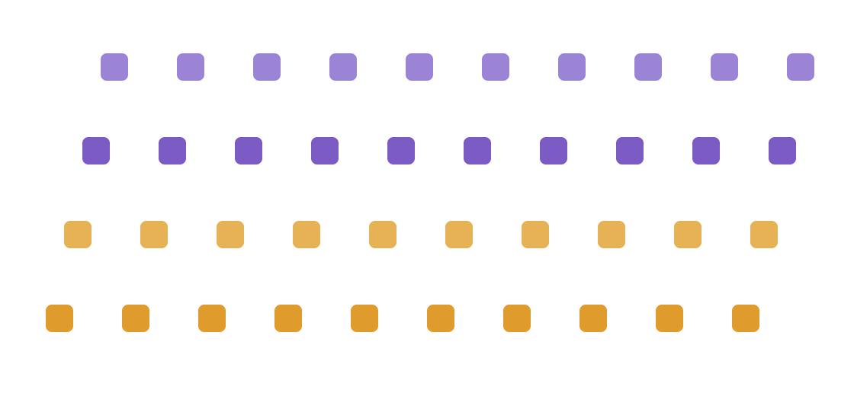
Noisy sensors in, noise-free truth out
DATA UNDERSTANDING · TWO KINDS OF ROWS
INPUT
500 000 surface sensors
TARGET
849 184 virtual nodes
At 20–30 m above ground, with measurement noise. 98.8 % real sensors (mask_i_obs = 1). 1.2 % interpolated: excluded from the input.
A 500 × 250 grid at 100 m on 12 levels, without noise. Used only to supervise and to score the model, never as input.
PC-FNO3D · First progress review · ANEO
16

Slide 17




The target already obeys the laws to learn
DATA UNDERSTANDING · PHYSICS OF THE TRUTH
Mass conservation
Ground condition
Thermodynamics
w from continuity · residual ≈ 1e-11
w = u·∂z/∂x + v·∂z/∂y at the first level
Hydrostatic (< 1.2 % error), ideal gas, Magnus humidity
Boundary layer
Large-scale balance
Diversity
Log profile, 200–1500 m height, nocturnal jet, slope winds
Geostrophic and thermal wind consistent with the surface
8 directions, calm to strong, 3 stability classes, 12 months
PC-FNO3D · First progress review · ANEO
17
Notes:
Checked in the pipeline before training: a truth violating continuity would make DSO2 impossible to reach.

Slide 18



Whole days, spread across the year
DATA UNDERSTANDING · ANTI-LEAKAGE SPLIT
70 days
15 days
15 days
Training · learning
Validation
Test
No leakage between sets
Train-only statistics
Unseen test
Every instant of a day, episodes included, belongs to one set only. No near-duplicate crosses the split.
Normalisation means and standard deviations come from training days only, then are applied to validation and test.
The 15 test days are never used for training or model selection.
PC-FNO3D · First progress review · ANEO
18

Slide 19
Data preparation & feature engineering
04
CRISP-DM · PHASE 3
From 1.35 billion rows to compact tensors and 25 physics-informed input channels.
19

Slide 20






Each instant becomes two tensors
DATA PREPARATION · TENSOR CACHE
Read
Group
Map
Tensorise
Cache
100 csv.gz files with pyarrow
by timestamp_utc → 1000 instants
point_id → grid cell or (level, row, col)
surface S and volume Y
.npy files + index, copied to Drive
S · (8, 250, 500)
Y · (4, 12, 250, 500)
u, v, w, T, ρ, RH, p + sensor-available flag on the 100 m grid
u, v, w, ρ on 12 levels · 0 under terrain + VALID mask
PC-FNO3D · First progress review · ANEO
20

Slide 21

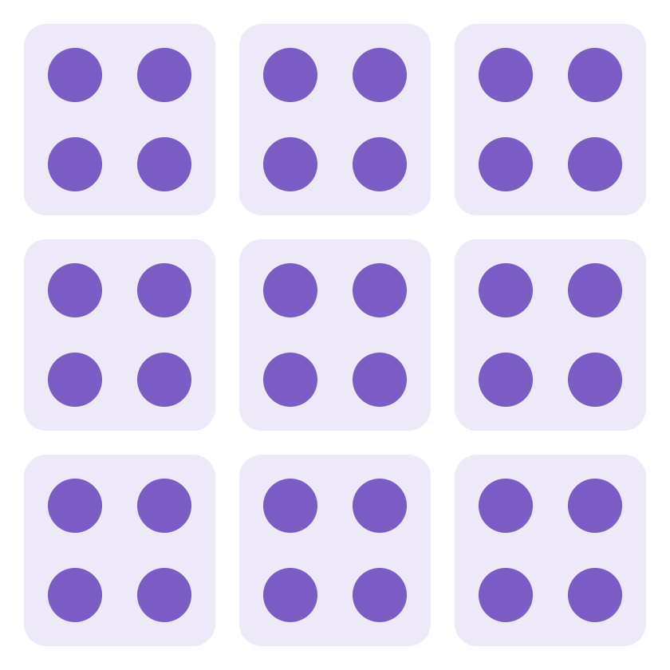

Every sensor counts: 2×2 pooling
DATA PREPARATION · SENSOR POOLING
Naive · 1 sensor in 4
Our choice · mean of the block
The model grid is 100 m, the sensors 50 m apart. Keeping one corner per block would ignore 375 000 measurements at each instant.
Each cell averages its available sensors (mask = 1). All 500 000 contribute, and measurement noise is averaged down.
PC-FNO3D · First progress review · ANEO
21

Slide 22
25 input channels, six roles
FEATURE ENGINEERING · OVERVIEW
7
1
6
3
4
4
Surface measurements · 7
Sensor availability · 1
Static terrain · 6
u, v, w, T, ρ, RH, p · z-score, 0 where hidden
1 = visible, 0 = masked
height, log z₀, slope, sin/cos aspect, sensor height
3D geometry · 3
Time · 4
Physics-derived · 4
altitude ASL, height above ground, valid mask
sin/cos of hour (with minutes) and of day-of-year
geostrophic wind u_g, v_g and thermal-wind shear
2D channels are copied on the 12 levels: the model reads a (25, 12, 250, 500) volume.
PC-FNO3D · First progress review · ANEO
22

Slide 23
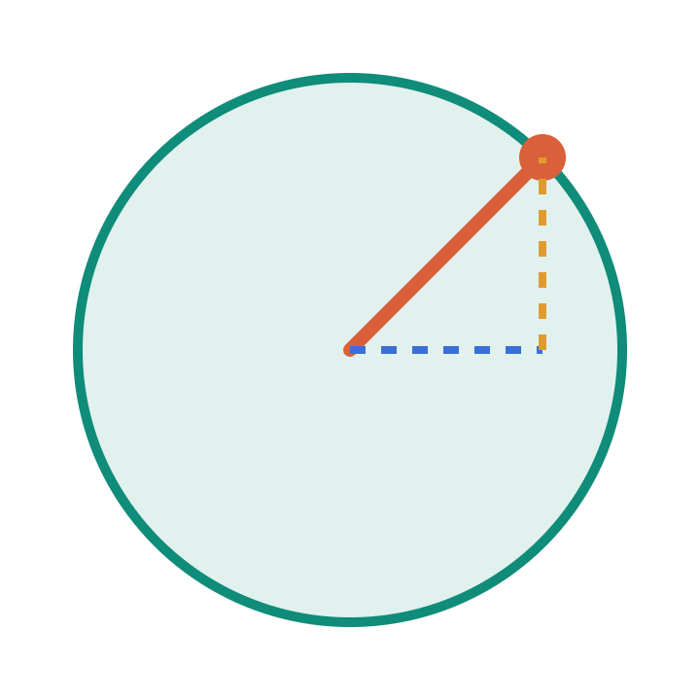
Turning the relief into model-ready numbers
FEATURE ENGINEERING · TERRAIN & GEOMETRY
z_terrain / 500
terrain height, scaled to ≈ [0, 1]
N
drives the log wind profile and blocking
45°
log z₀ (standardised)
surface roughness on a log scale
z₀ spans 1e-4 to 1 m: the log makes it usable
slope / 10
terrain slope in degrees
orographic lifting, source of w
sin, cos (aspect)
slope orientation as a point on a circle
359° and 1° stay neighbours
+ 3 CHANNELS PER LEVEL
altitude ASL / 1000 · height above ground / 1000 · valid-node mask
sensor height
(z_rel − 25) / 5
sensors sit 20–30 m above ground
PC-FNO3D · First progress review · ANEO
23
Notes:
Every static feature is scaled to order one so that no channel dominates the lifting layer. Aspect is an angle, so it is encoded on the unit circle.

Slide 24
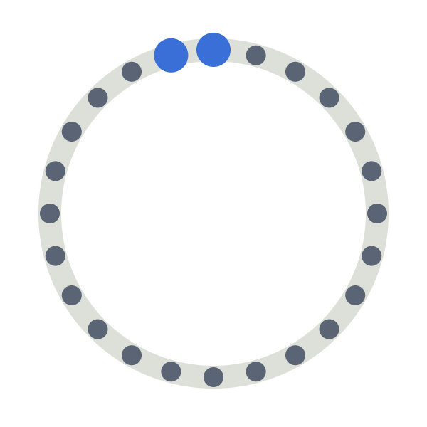



Time is a circle, not a line
FEATURE ENGINEERING · TIME ENCODING
24 h
365 d
Why not raw hours?
With h = 0…23, midnight and 23 h look as far apart as possible. The circle removes this artificial jump.
sin, cos (2π·(h + min/60)/24)
sin, cos (2π·doy/365)
23:50 and 00:10 are 20 minutes apart, so they must be neighbours. Minutes are kept for the minute and 10-second episodes.
28 December and 1 January share the same winter conditions: the season wraps around too.
Normalisation
Surface variables: z-score with training-day statistics only, then set to 0 where a sensor is hidden.
PC-FNO3D · First progress review · ANEO
24

Slide 25
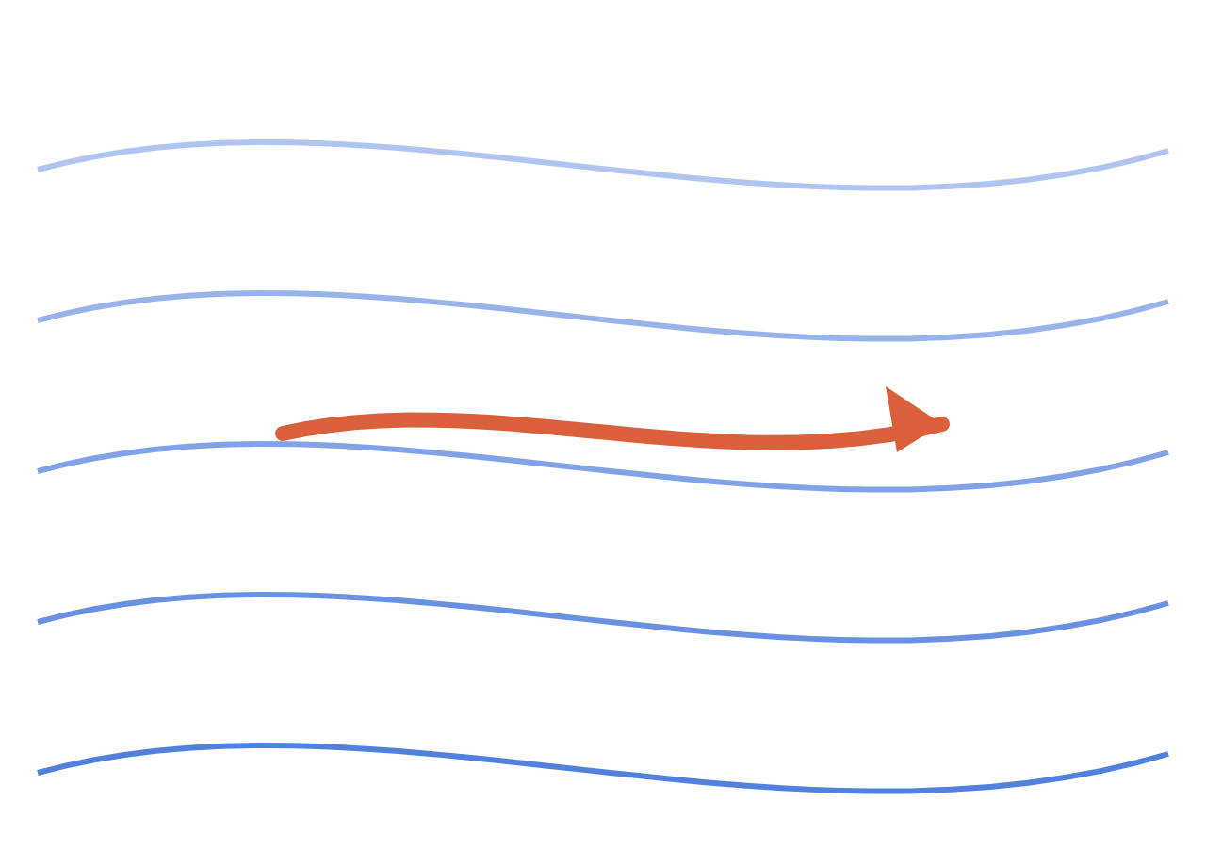
The altitude signal hidden in surface balances
FEATURE ENGINEERING · PHYSICS-DERIVED FEATURES
L
Geostrophic wind
u_g = −(1/ρf)·∂p/∂y v_g = (1/ρf)·∂p/∂x
Plane fitted to sea-level pressure of the visible sensors · f = 8.57·10⁻⁵ s⁻¹ (≈ 36° N)
geostrophic wind
Thermal wind
∂(u_g, v_g)/∂z = g/(fT)·(−∂T/∂y, ∂T/∂x)
How the wind turns and strengthens with height
H
PC-FNO3D · First progress review · ANEO
25
Notes:
Above the boundary layer, the wind tends to the geostrophic wind, parallel to the isobars. The surface pressure field therefore carries information about the wind aloft.

Slide 26



Hiding sensors on purpose
DATA PREPARATION · ROBUSTNESS BY DESIGN
100 %
50 %
20 %
upper end of training
fixed in validation and test
lower end of training
For each training sample a random 20–100 % of sensors stays visible. The model learns to fill gaps, not to copy sensors (BO4, DSO5).
PC-FNO3D · First progress review · ANEO
26

Slide 27
Modeling
05
CRISP-DM · PHASE 4
A Fourier neural operator in three dimensions, trained with the physics it must respect.
27

Slide 28



Learning a map between whole fields
MODELING · NEURAL OPERATOR
Gθ
learned operator · global mixing by FFT in O(N log N)
Surface fields + terrain
3D wind u, v, w
25 channels on the grid
12 levels up to 1 km
Classical ML learns values at points; a neural operator learns the mapping between functions, so it captures structures across the whole domain at once.
PC-FNO3D · First progress review · ANEO
28

Slide 29


Inside the operator
MODELING · PC-FNO3D
Input
Lift
Fourier layer × 4
Project
Output
25 × 12 × 250 × 500
1×1×1 conv · 25 → 48
spectral + skip + local
48 → 128 → 3 · fp32
u, v, w · 12 levels
ZOOM · ONE FOURIER LAYER
FFT 3D
Keep low modes
× learned weights
inverse FFT
to frequency space
6 × 32 × 32 (z, y, x)
complex, per mode
back to the grid
+ 1×1 skip: pointwise mixing
+ 3×3×3 local conv: details below 1.6 km
+ GELU
453 M
4·8·8
91 ms
parameters
zero padding
per instant
almost all in the Fourier weights
limits FFT wrap-around at borders
A100 inference
PC-FNO3D · First progress review · ANEO
29

Slide 30


One loss, four forces
MODELING · PHYSICS-CONSTRAINED LOSS
L =
L_data
+ 0.15·
L_grad
+ φ(t)·[
L_mass
/ 5e-7 + 0.1·
L_bc
]
L_data
L_grad
L_mass
L_bc
MSE on valid nodes · w weighted up to ×25 per level
relative error of horizontal gradients
continuity residual, same discrete operator as the data
w = u·∂z/∂x + v·∂z/∂y at the first node
Physics warm-up φ(t)
Exact discrete operator
Physics weight rises linearly over 10 epochs: the model first learns the data, then the constraints.
r = (ρw[k+1] − ρw[k])/Δz + ½(D[k] + D[k+1]) with D = ∂(ρu)/∂x + ∂(ρv)/∂y
PC-FNO3D · First progress review · ANEO
30

Slide 31








Stable, reproducible, resumable
MODELING · TRAINING SETUP
AdamW
OneCycle cosine
140 epochs
Mixed precision
lr 1e-3 · weight decay 1e-4
10 % warm-up, smooth decay
× 400 random instants
bf16, FFT and head in fp32
EMA of weights
Validation
NVIDIA A100
Checkpoints
decay 0.999 for validation
synoptic instants, 15 days
≈ 120 s per epoch
local each epoch, Drive / 5
PC-FNO3D · First progress review · ANEO
31

Slide 32

Choosing the model by the objectives
MODELING · MODEL SELECTION
Final model: end of training
Fine-tuning tested, not kept
140 epochs, EMA weights (decay 0.999), checked on the synoptic validation instants. This is the model evaluated on the test set.
An extra DSO-oriented fine-tuning degraded the score from its first epochs: it was stopped and the trained model kept.
DSO SCORE USED TO COMPARE MODELS · ≤ 1 MEANS ALL OBJECTIVES MET
max( RMSE / 0.5 , mass / 1e-4 , max(rough − 1, 0) / 0.1 , (1 − R²min) / 0.05 )
PC-FNO3D · First progress review · ANEO
32

Slide 33

Every component answers a measured problem
MODELING · DESIGN CHOICES
Mass residual floor
Output head in fp32
Fields too smooth
3×3×3 local branch + gradient loss
bf16 rounding of the output
Truncation at 32 Fourier modes
Noisy surface input
2×2 pooling of all sensors
Unstable model selection
Synoptic validation + EMA
Sensors 50 m apart, grid 100 m
Near-duplicate episode instants
Stricter mass smooths fields
Mass weight kept moderate
Long runs interrupted
Local save + Drive copy / 5 epochs
Smoothing lowers divergence
Multi-GB checkpoints on Drive
PC-FNO3D · First progress review · ANEO
33

Slide 34
Test R² of u: baselines at 25 m, PC-FNO3D at every level
MODELING · MODEL COMPARISON
ConvResNet
0.969
CNN · 25 m
ViT
0.722
Transformer · 25 m
DeepONet
0.913
Operator · 25 m
PC-FNO2D
0.988
Fourier 2D · 25 m
PC-FNO3D
0.991
worst level, 100–1000 m
0.70
0.80
0.90
1.00
GNN (GATv2) diverged. Baselines were scored at 25 m on the first 30-day dataset; PC-FNO3D on 12 levels against an independent truth. The 3D task is harder, yet its worst level beats the best 2D model.
PC-FNO3D · First progress review · ANEO
34

Slide 35



CNN vs PC-FNO2D vs PC-FNO3D
MODELING · WHY PC-FNO3D
ConvResNet
PC-FNO2D
PC-FNO3D
CNN baseline
first operator
final model
Local receptive field (≈ 20 km)
Global view through 2D FFT
3D FFT + local branch, 12 levels
No physics in the loss
2D divergence only
Full 3D continuity + terrain condition
Surface only (25 m)
No truth aloft: profile not verifiable
Scored against an independent truth to 1 km
R² u 0.969 at 25 m
R² u 0.988 at 25 m
R² u ≥ 0.991 at every level · 91 ms
PC-FNO3D · First progress review · ANEO
35

Slide 36
Evaluation
06
CRISP-DM · PHASE 5
Scored on 15 unseen days, level by level, against the business and data-science objectives.
36

Slide 37
Below 0.5 m/s up to 500 m, above it only near 1 km
RESULTS · TEST SET PER LEVEL
1000 m
0.67 · 0.51
RMSE u (m/s)
800 m
0.63 · 0.47
RMSE v (m/s)
650 m
0.56 · 0.41
DSO1 target 0.5
500 m
0.48 · 0.39
0.542 · 0.437
400 m
0.47 · 0.40
300 m
0.46 · 0.42
global RMSE u · v
all 3D nodes, 100–1000 m
200 m
0.46 · 0.44
150 m
0.48 · 0.46
≥ 0.991
100 m
0.46 · 0.44
R² of u and v
at every level
120 synoptic test instants, 50 % of sensors. u exceeds 0.5 m/s only at 650–1000 m, where winds are strongest; the WMO-style relative criterion is met everywhere.
PC-FNO3D · First progress review · ANEO
37

Slide 38

Five objectives met, one partly met
RESULTS · DSO STATUS (TEST SET)
DSO1
DSO1
DSO2
R² u, v, w per level
Global RMSE ≤ 0.5
Mass residual ≤ 1e-4
0.966–0.998
u 0.542 · v 0.437
2.58e-5
Met
v met · u partly
Met · 4× margin
DSO3
DSO4
DSO5
Roughness ≤ 1.1
Inference < 1 s
25 % sensors ≤ 0.7
0.951
91 ms
0.646 m/s
Met
Met
Met
R² per level: u, v 0.991–0.998 · w ≥ 0.966. Indicators: wind direction error 3.6° (winds ≥ 1 m/s) · rapid episodes included, mass residual 3.0e-5.
PC-FNO3D · First progress review · ANEO
38

Slide 39
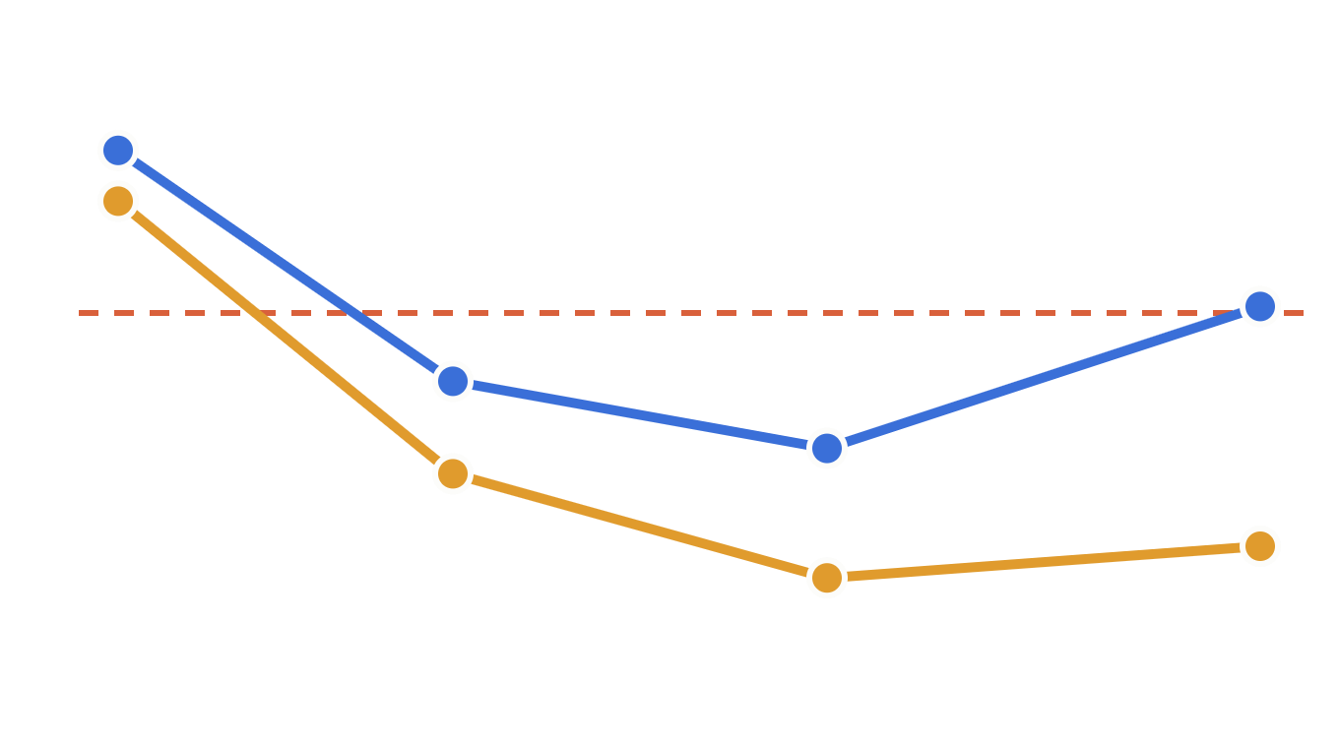
Steady with few sensors, harder on fast events
RESULTS · ROBUSTNESS & STRESS TESTS
Worst-level RMSE vs visible sensors
R² of u on rapid episodes, by level (m)
0.92
0.96
0.97
0.98
0.86
0.84
0.85
0.86
0.90
DSO5 · 0.7 m/s
10 %
25 %
50 %
100 %
100
150
200
300
400
500
650
800
1k
u
v
Fronts, gusts and breezes: one snapshot, no information on how the wind changes.
PC-FNO3D · First progress review · ANEO
39

Slide 40
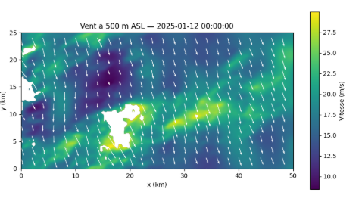
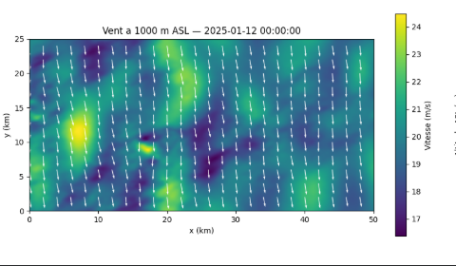
12 January 2025, 00:00 UTC: the wind at two altitudes
RESULTS · A RECONSTRUCTED INSTANT
500 m
Southwest–northeast bands of 20–28 m/s and calm pockets near the relief; white patches are summits above the level.
1000 m
Stronger, more uniform northerly flow (17–24 m/s): the wind decouples from the terrain and tends to the geostrophic wind.
PC-FNO3D · First progress review · ANEO
40
Notes:
Reconstruction from surface sensors only, 109 ms. Colour scales differ between the two maps: 8–28 m/s at 500 m, 17–24 m/s at 1000 m.

Slide 41
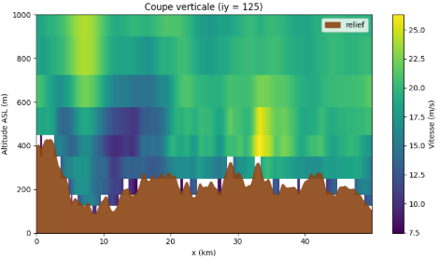


Vertical section across the domain
RESULTS · A RECONSTRUCTED INSTANT
Terrain first
No nodes below the relief: the reconstruction follows the real topography.
Speed grows with height
Slow air in the valleys (≈ 8 m/s), faster aloft: the boundary-layer profile.
Nocturnal jet
≈ 25 m/s between 400 and 1000 m above x ≈ 33 km, as expected on a winter night.
PC-FNO3D · First progress review · ANEO
41
Notes:
Section along the middle row of the grid. The 12 levels give the stepped look; the app will interpolate vertically for a smooth image.

Slide 42
What these results do and do not show
FIRST RESULTS · HONEST READING
A synthetic truth
Density aloft
Scores measure how well the model learned the generator's physics. Validation on LiDAR or radiosonde profiles is the next step.
The mass residual uses the true ρ at altitude. In deployment it must be estimated from the surface (hydrostatic + ideal gas).
One snapshot at a time
Domain size
No temporal context: rapid episodes stay the hardest cases below 400 m.
50 × 25 km at 100 m. Scaling to the real ANEO grid (≈ 1.25 M nodes) is future work.
PC-FNO3D · First progress review · ANEO
42

Slide 43
Deployment plan
07
CRISP-DM · PHASE 6
Turning the trained operator into a tool: reconstruct any instant and explore it in 3D.
43

Slide 44








From a surface CSV to an interactive 3D field
DEPLOYMENT · ARCHITECTURE
Reconstruction engine · aneo3d
Quality control · available sensors, physical bounds
Preprocessing · pooling, normalisation, geostrophic wind
ANEO surface CSV
PC-FNO3D inference · ≈ 91 ms per instant on GPU
3D app
Physics checks · mass residual, ground condition
Streamlit + Plotly
one instant
Exports · NetCDF · NPZ · virtual-node CSV
model checkpoint (.pt)
norm_stats.json
meta.json
aneo_grid_points.csv
PC-FNO3D · First progress review · ANEO
44
Notes:
Status: implemented in the aneo3d package and the Streamlit app. Quality control rejects sensors outside physical bounds; the app shows the mass residual, the ground condition and the end-to-end time for every reconstruction.

Slide 45
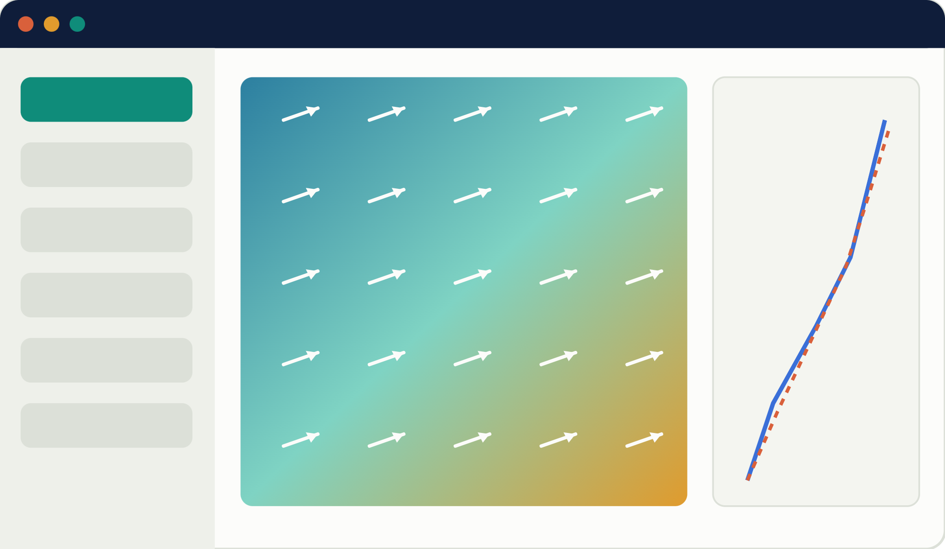
Six pages, one per question a user asks
DEPLOYMENT · THE APPLICATION
Horizontal map
1
Horizontal map
Vertical
2
Vertical section
Vertical
3
Vertical profile
3D view
4
3D view
Live
5
Live · sensor failures
6
Validation & DSOs
Validation
wind at 120 m · arrows = direction
profile vs truth
PC-FNO3D · First progress review · ANEO
45

Slide 46

Two ways to run it, every BO visible
DEPLOYMENT · HOSTING & VALUE
Live demo
Permanent link
Streamlit on a Colab GPU through a cloudflared tunnel: real-time reconstruction, ≈ 91 ms per instant.
Hugging Face Spaces (CPU) with precomputed test instants: always available for the jury and the supervisor.
BO1
BO2
BO3
BO4
maps, sections, profiles, 3D view, node export
mass residual shown for each reconstruction
smooth fields, no artefacts
end-to-end time displayed
PC-FNO3D · First progress review · ANEO
46

Slide 47








An open-source Python stack, end to end
DEPLOYMENT · TOOLS
PyTorch
NumPy · pandas · SciPy
xarray + netCDF4
Streamlit
Model loading, GPU inference in bf16
Quality control, pooling, features, metrics
NetCDF export for GIS and ParaView
Web app: pages, controls, downloads
Plotly
Google Colab + Drive
cloudflared
Hugging Face Spaces
Maps, sections, profiles, 3D slices and cones
GPU runtime, model and cache storage
Public HTTPS link to the running app
Permanent hosting, files in Git LFS
Also: GitHub for the code · Docker for a reproducible image · Playwright for automatic app checks.
PC-FNO3D · First progress review · ANEO
47
Notes:
Inference and preprocessing run in Python with PyTorch and NumPy; the Streamlit app draws everything with Plotly. On Colab the app is reached through a cloudflared tunnel; for a link that never sleeps, Hugging Face Spaces serves the precomputed test instants.

Slide 48
Next steps
08
AFTER THIS REVIEW
What is done, what is running now, and what comes before the final defence.
48

Slide 49


Done, running, next
PROGRESS
Done
Running
Next
BOs and measurable DSOs
Error analysis at 650–1000 m
Permanent hosting on Hugging Face
3D dataset v2 analysed
Density aloft estimated from the surface
Report and final defence
Tensor pipeline + 25 channels
PC-FNO3D trained (140 epochs)
aneo3d engine + Streamlit 3D app on Colab
Test evaluation against the DSOs
PC-FNO3D · First progress review · ANEO
49

Slide 50
What this first review shows
TAKEAWAYS
12
≥ 0.99
91 ms
2.6e-5
levels reconstructed
R² of u and v
per instant
mass residual
from 25 m up to 1 km
every level, unseen days
near real time on one GPU
4× below the DSO2 threshold
A physics-constrained Fourier operator rebuilds the wind aloft from surface sensors alone: five of six DSO criteria met, u error just above target only near 1 km. Next: the deployed app and validation on real profiles.
PC-FNO3D · First progress review · ANEO
50

Slide 51

Thank you
Questions & discussion
Ines Rouatbi · ISI / ESPRIT · Tukhnanutha · 2026

